Slide 1


BUA 751 : Machine Learning for Business
Homework 3 – Assignment : House Price Analysis
Group 1
Priyamvada Barve
Nandita Pathardikar
Prasun Abhishek Singh

Slide 2
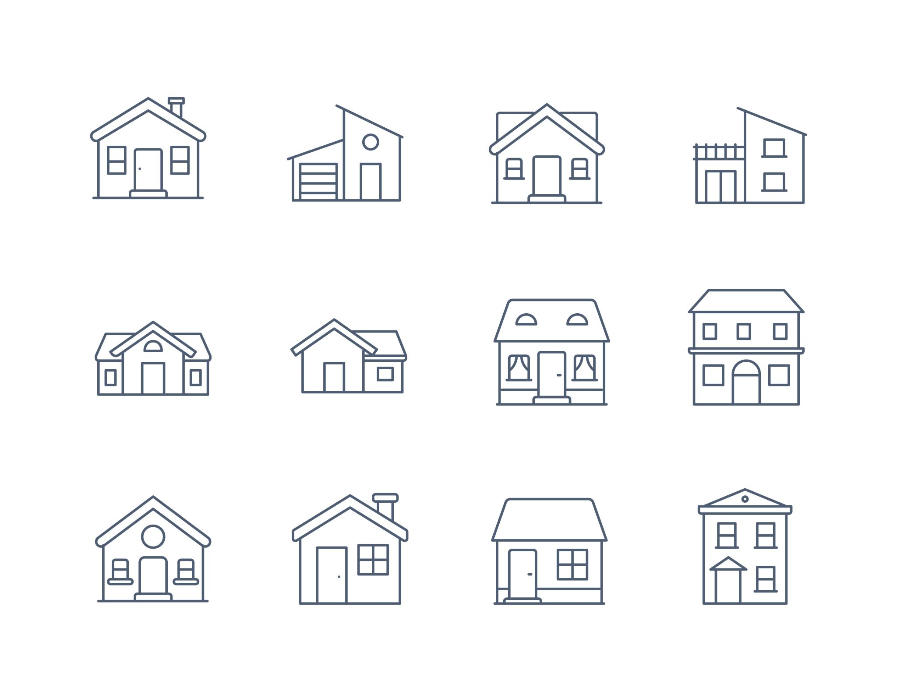
Dataset Description
Dataset consists of different factors that influence house price.
Sales price of house depends on following factors:
- quality of house
- number of garage spaces
- Number of full and half bathrooms
- square feet of living area

Slide 3
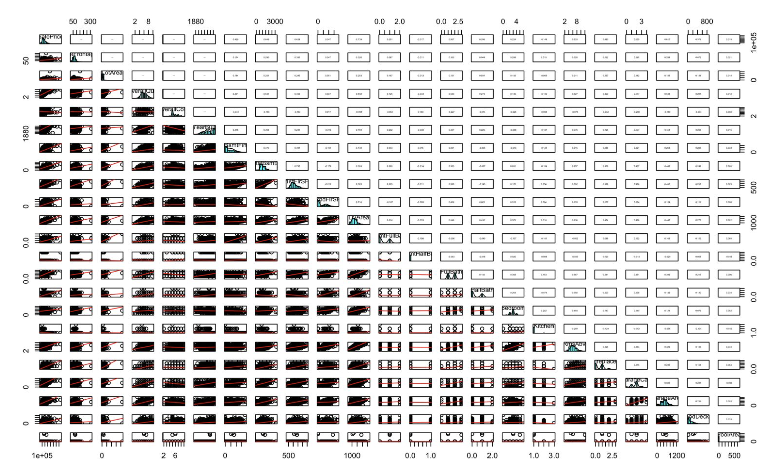
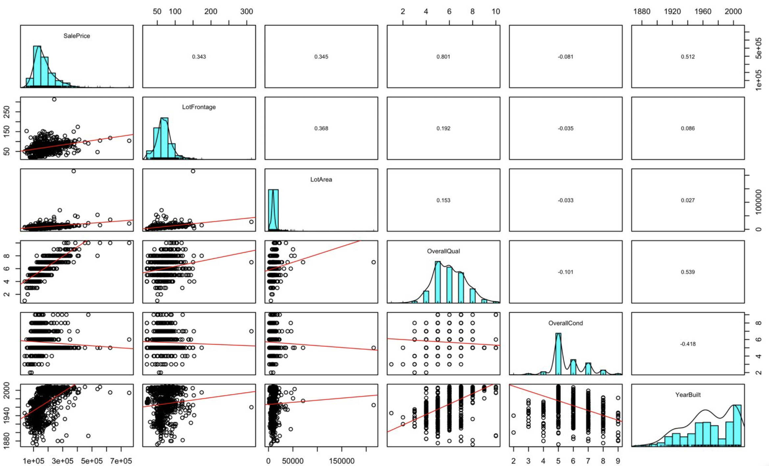
Overall view of relationship of the continuous dependent variable (SalePrice) with all continuous X-variables
Pair panel – Used for quick exploratory data analysis, shows trends, histogram (frequency), correlation

Slide 4
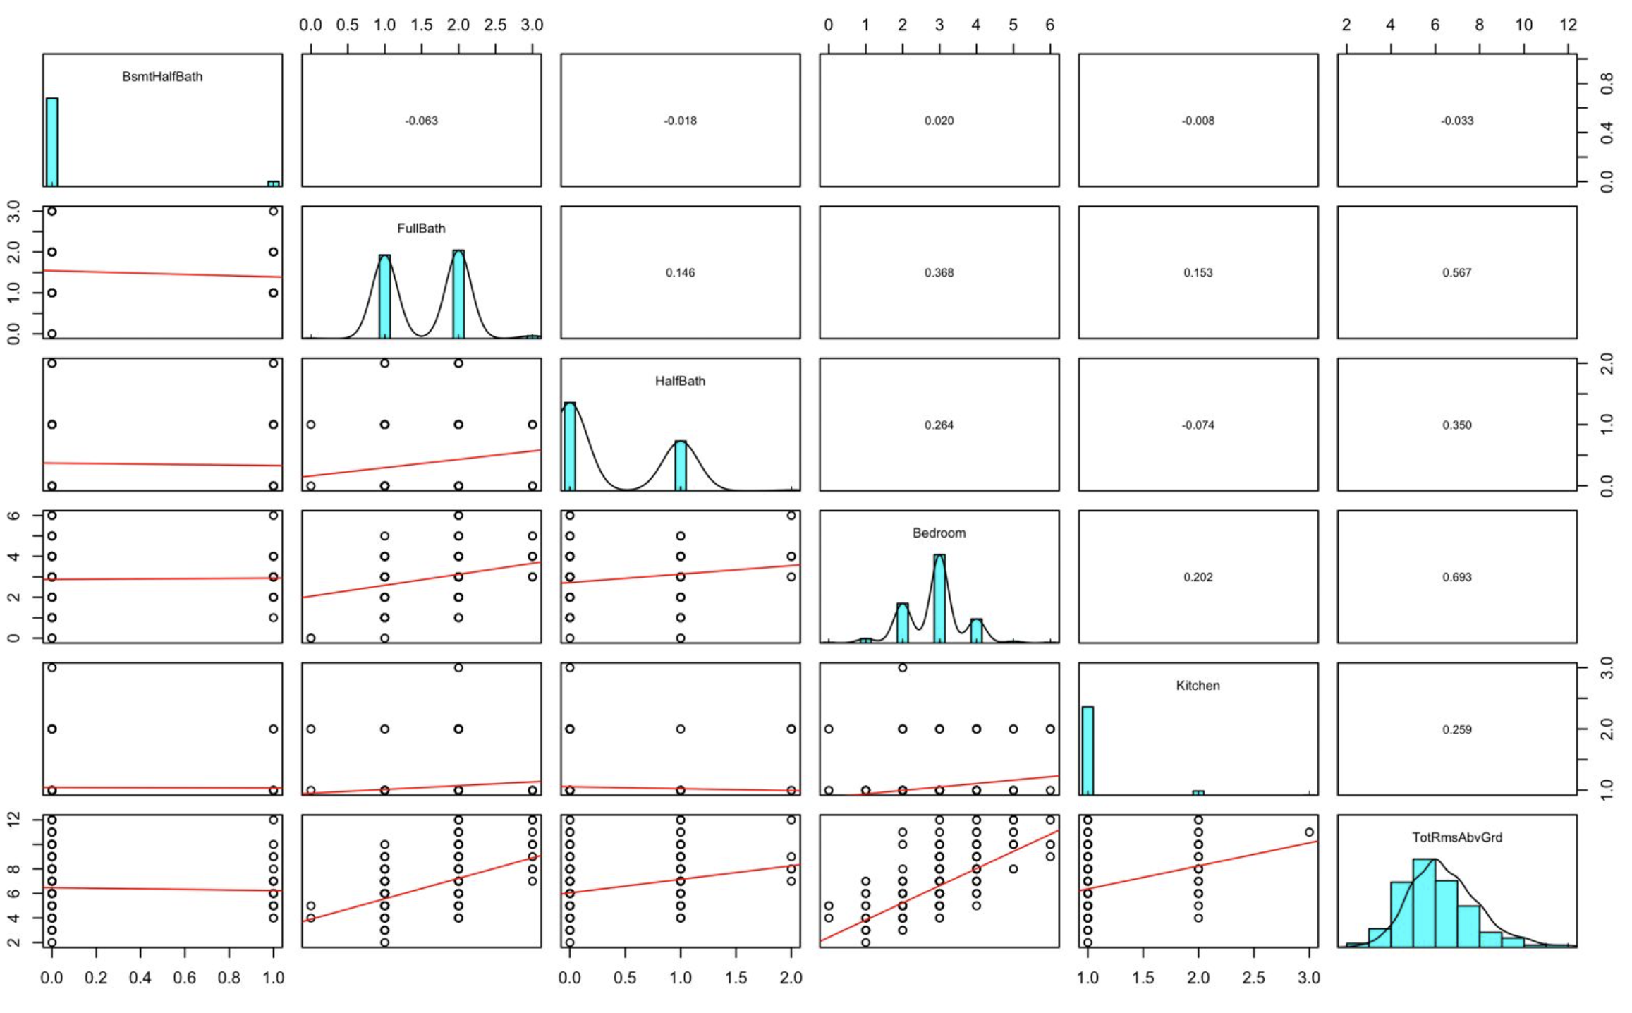
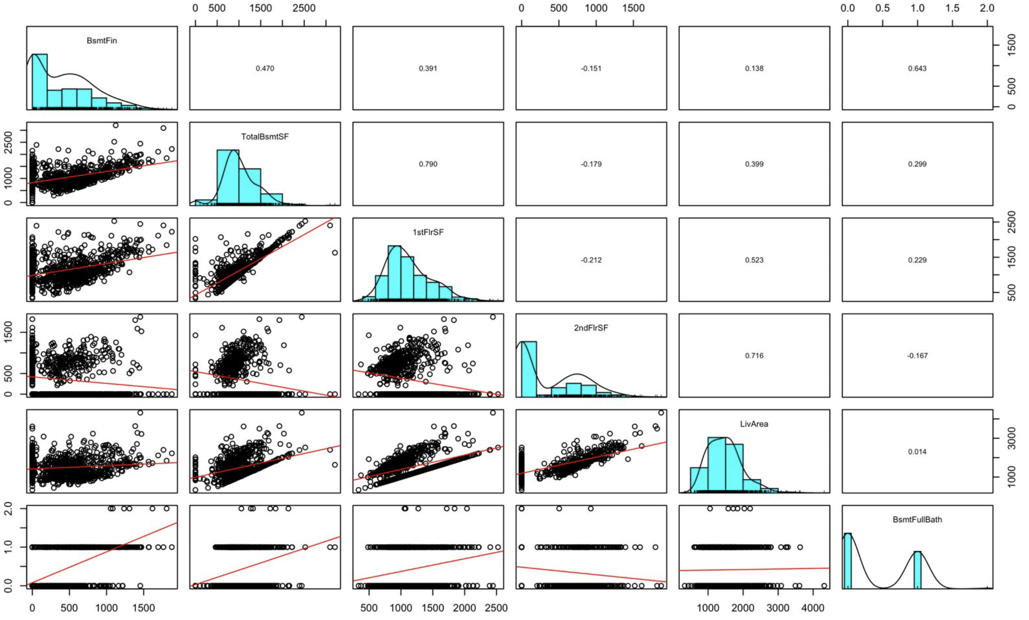
We couldn’t get relationship with all variables together using pair panel, as the resulting graph will be unreadable due to several attributes. Correlation matrix might get an accurate overall view of all variables with price.

Slide 5
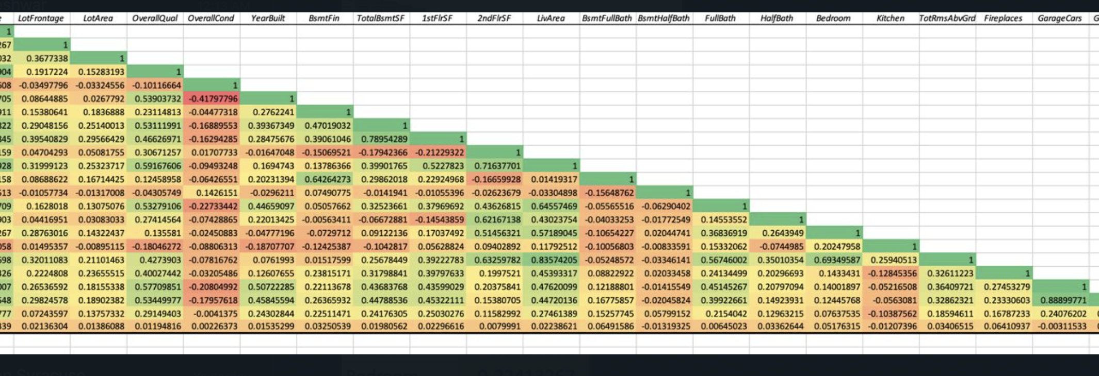
Correlation of various factors with Sales Price

Slide 6
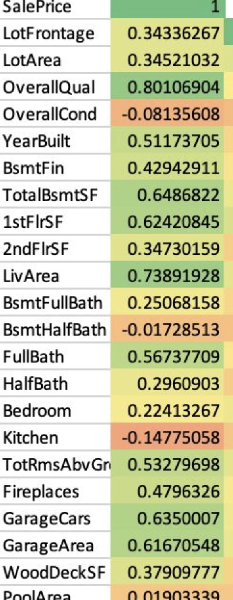
Factors Influencing House Price
Two of the highest correlation found with Sales Price
OverallQual – 0.80106
LivArea – 0.73891
Overall quality of the house and living area influence the sales price of the house the most.

Slide 7
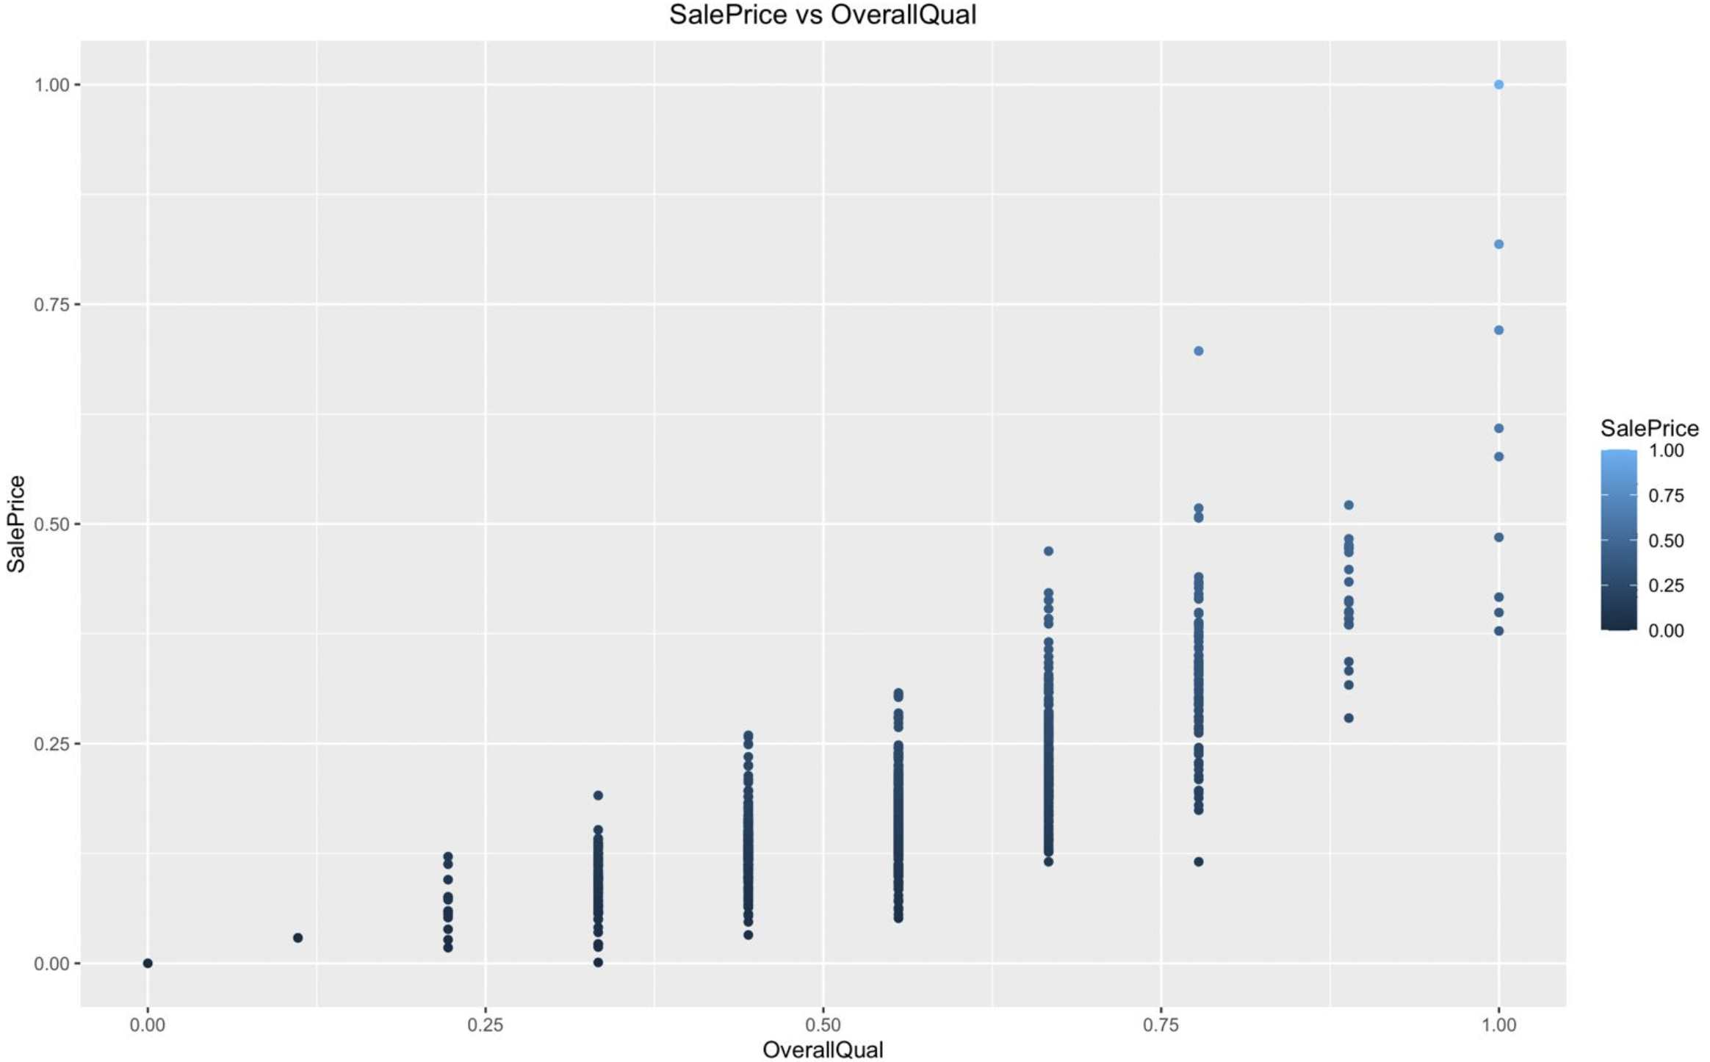
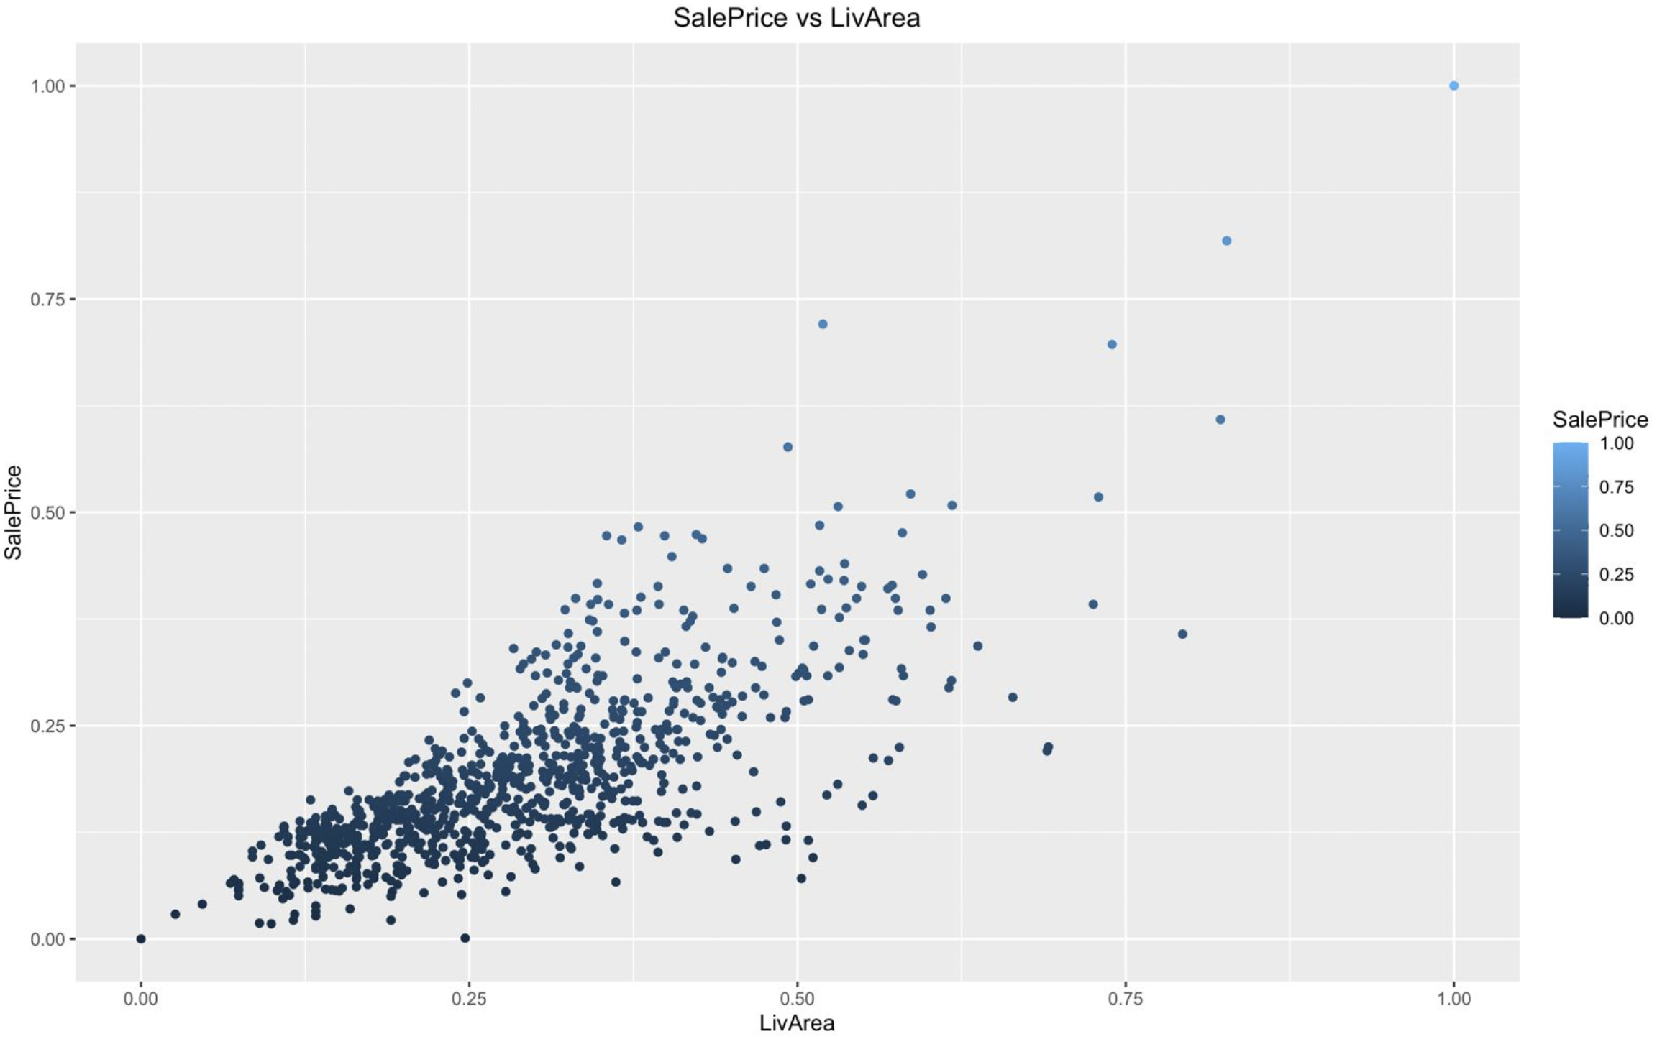
Graphs – strong relationship of x variables with sales price
Both the graphs show linear relationship of x variable with sales price

Slide 8
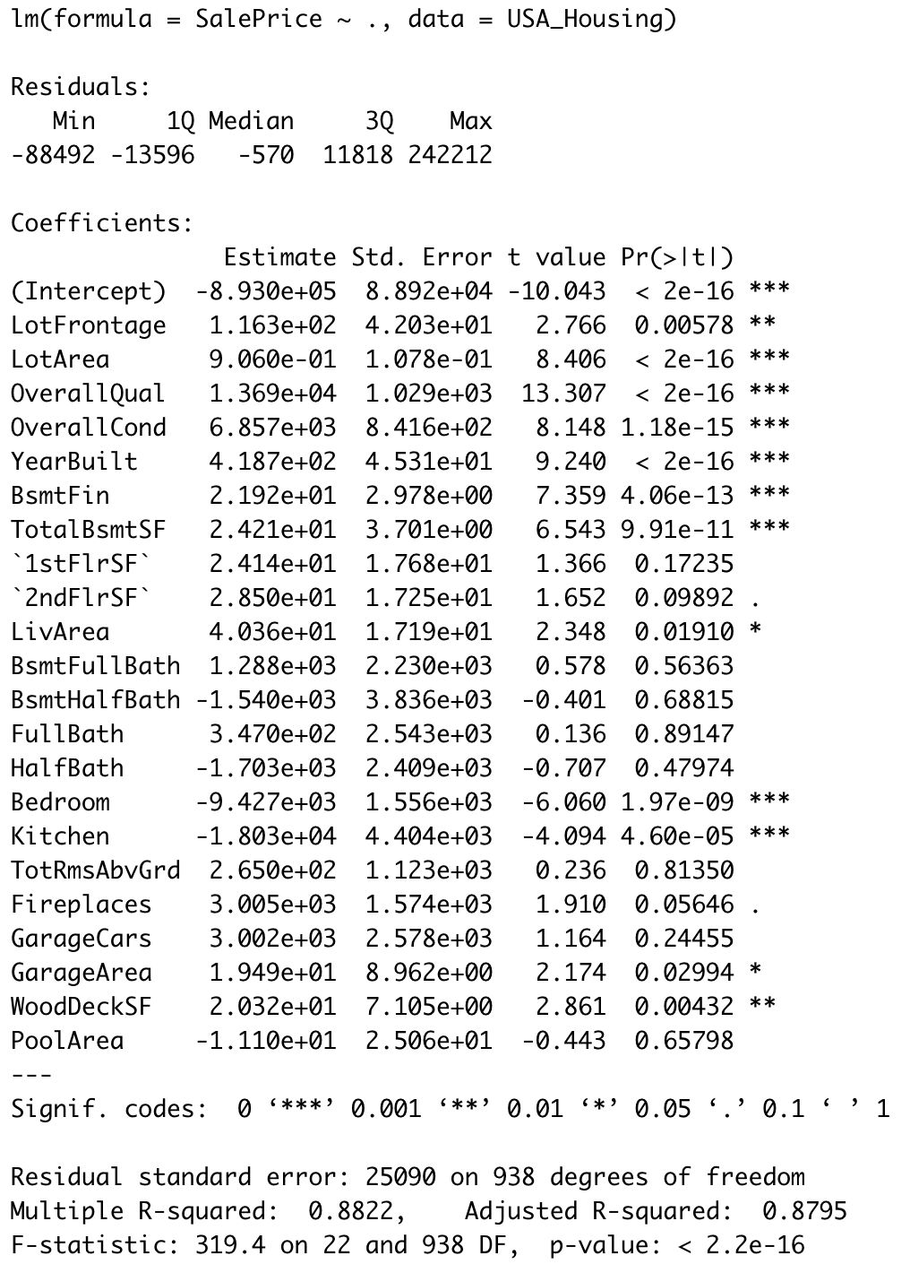
Lm Model

Slide 9
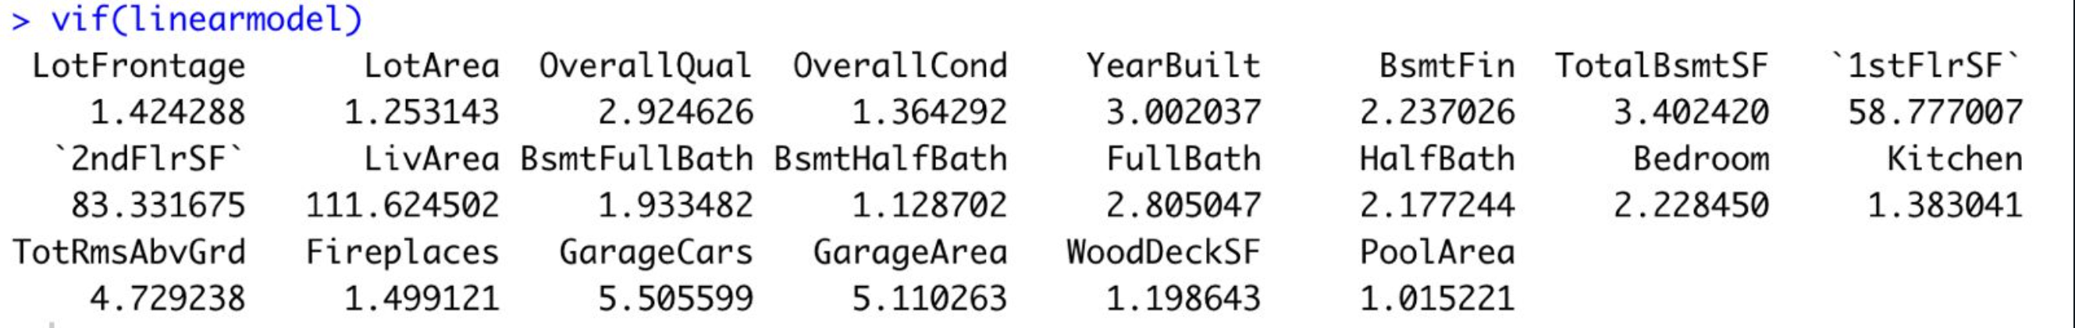
Variance Inflation Factor
VIF (Variance Inflation Factor) can be used to identify multicollinearity by assigning each attribute a score.
A VIF value of less than 10 indicates that the predictor variable is not highly correlated with the other predictor variables in the regression model, and therefore, there is no serious multicollinearity problem.
To remove multicollinearity, we can remove correlated independent variables or combine them.

Slide 10
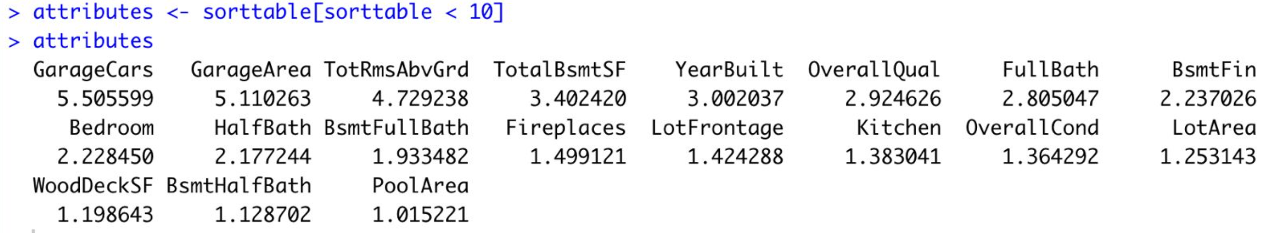
VIF less than 10
After VIF analysis we see 19 variables which are distinct.

Slide 11
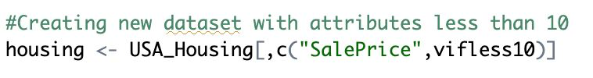
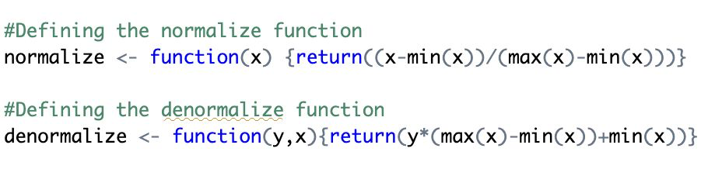
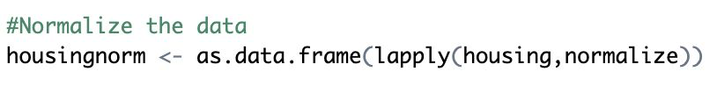
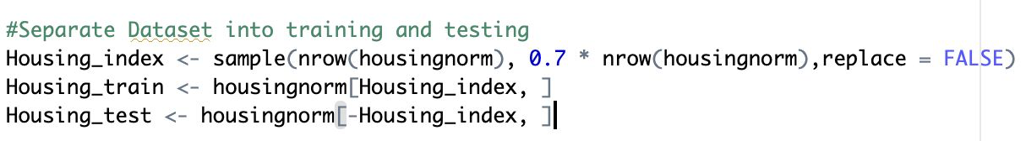
Variables with VIF <10
We create a new dataset with VIF <10 variables and sales price
Creating normalize and denormalize functions
Normalizing the data
Creating training data and testing data by splitting 70% and 30%

Slide 12
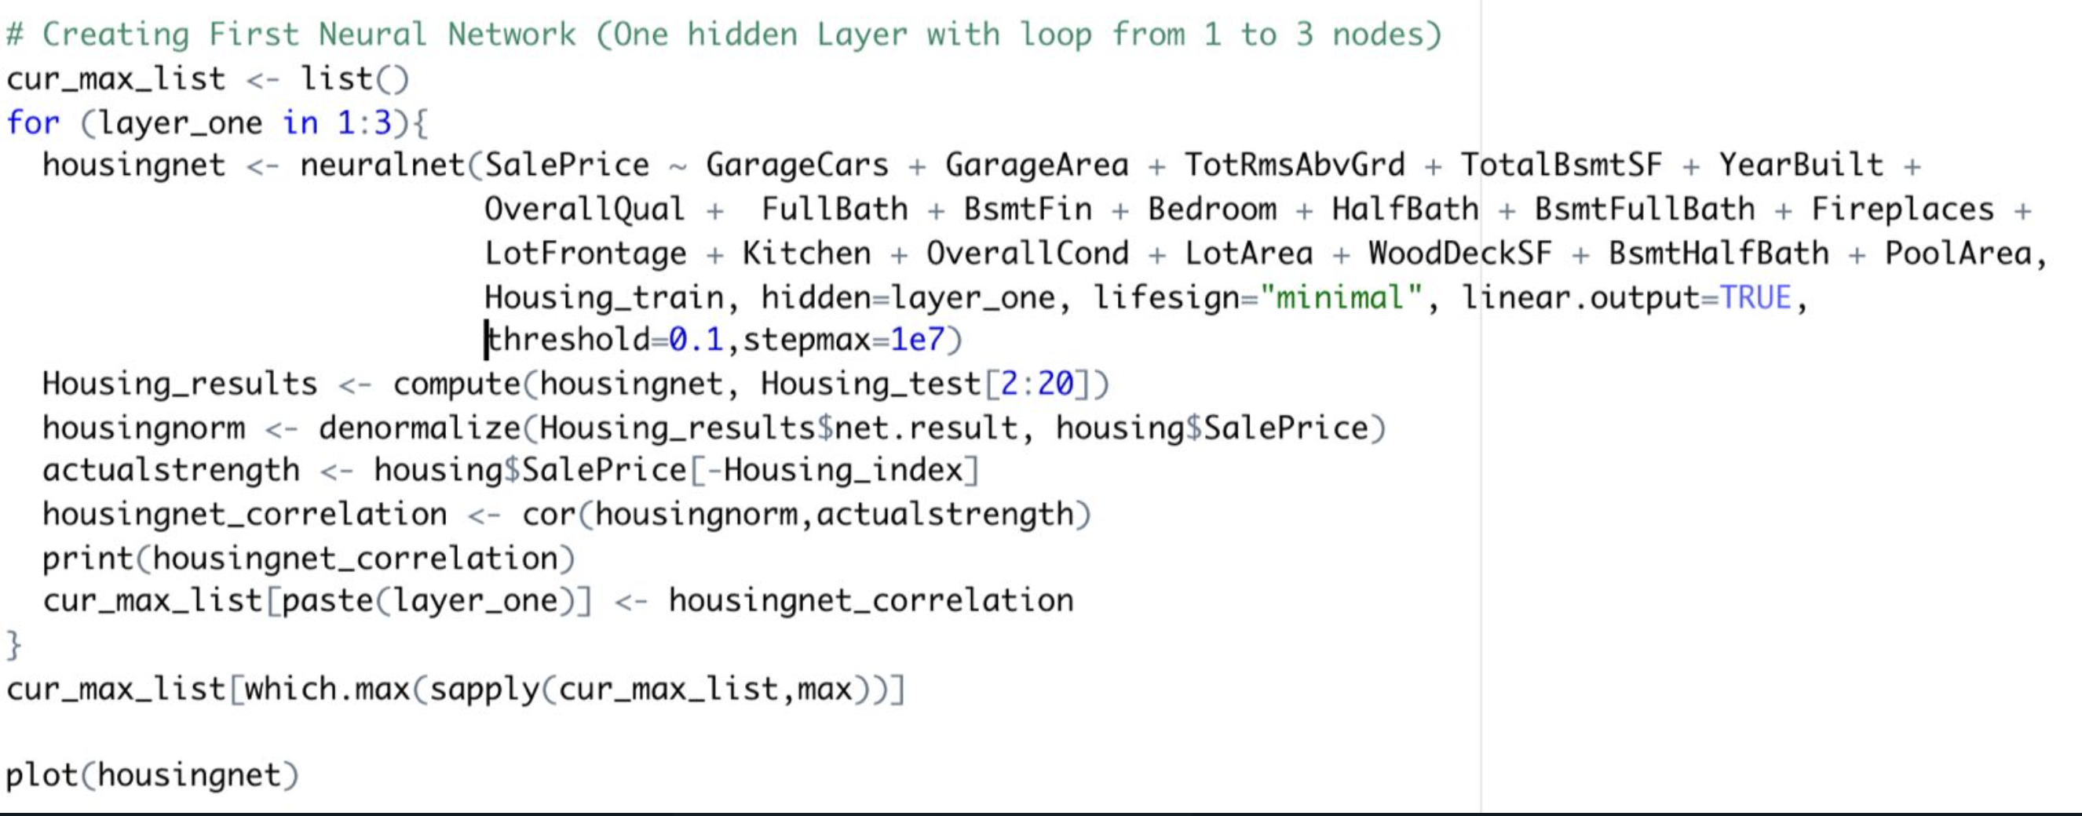
Neural Network (single layer)
In this neural network one hidden layer contains loop of 1 to 3 hidden nodes, using 70% training data, randomly selected variables having VIF< 10.
Testing is done with the remaining 30% of the data.

Slide 13
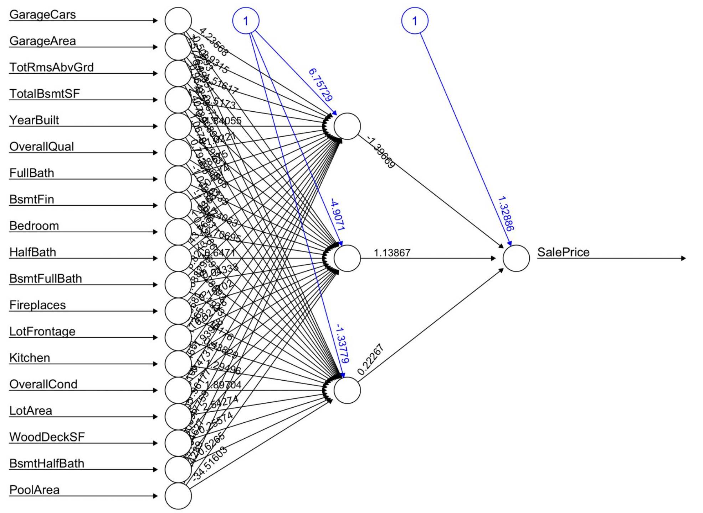
Visual Representation of the Neural Network with 1 Hidden Layer and 3 Nodes

Slide 14
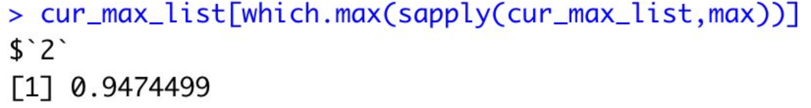
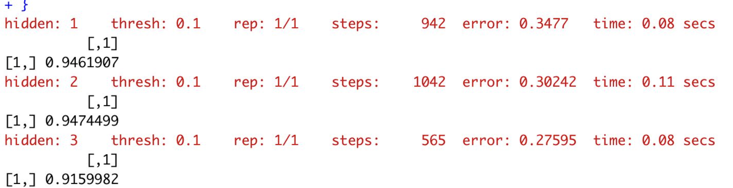
Testing our model
In this instance we got 1 layer 2 nodes configuration as highest accuracy.
1 Hidden layer with 1 to 3 nodes

Slide 15
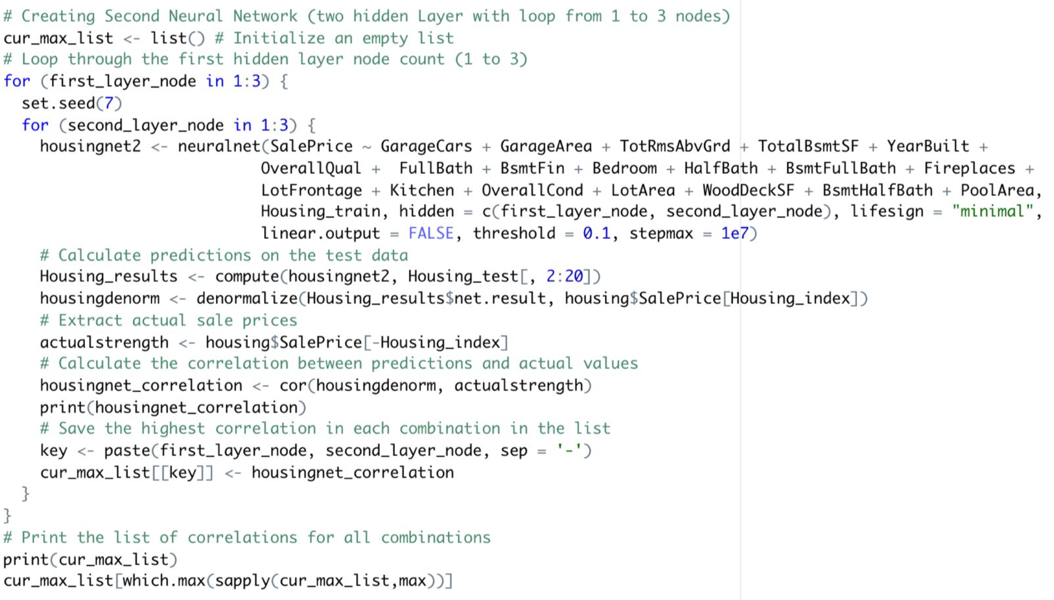
Neural Network (two layer)
In this neural network two hidden layer contains loop of 1 to 3 hidden nodes, using 70% training data, randomly selected variables having VIF< 10.
Testing is done with the remaining 30% of the data.

Slide 16
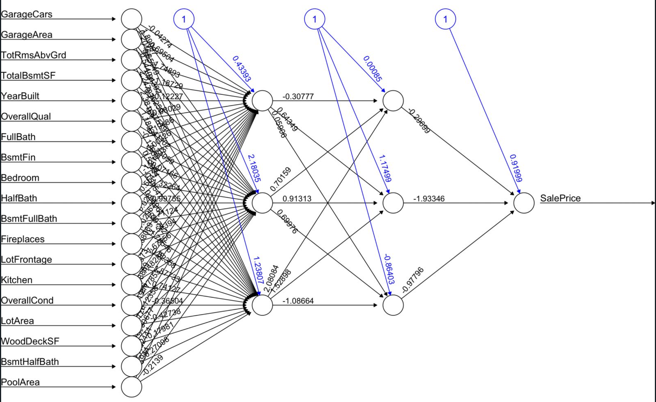
Visual Representation of the Neural Network with 2 Hidden Layer and 3 Nodes in both layers

Slide 17
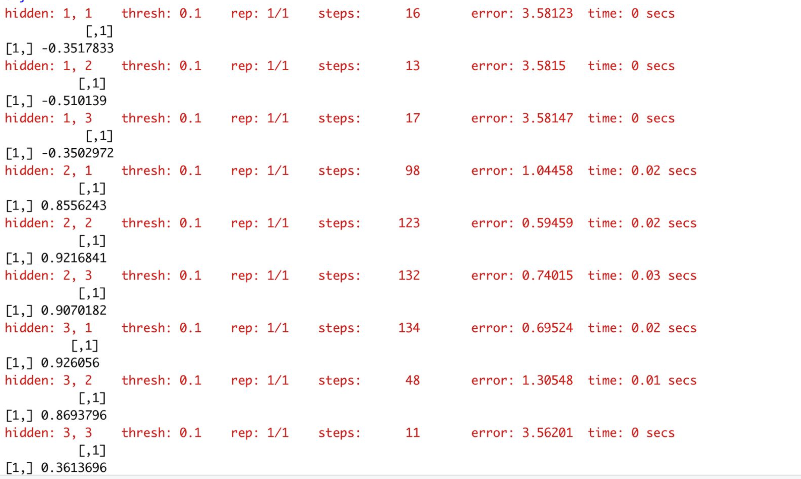
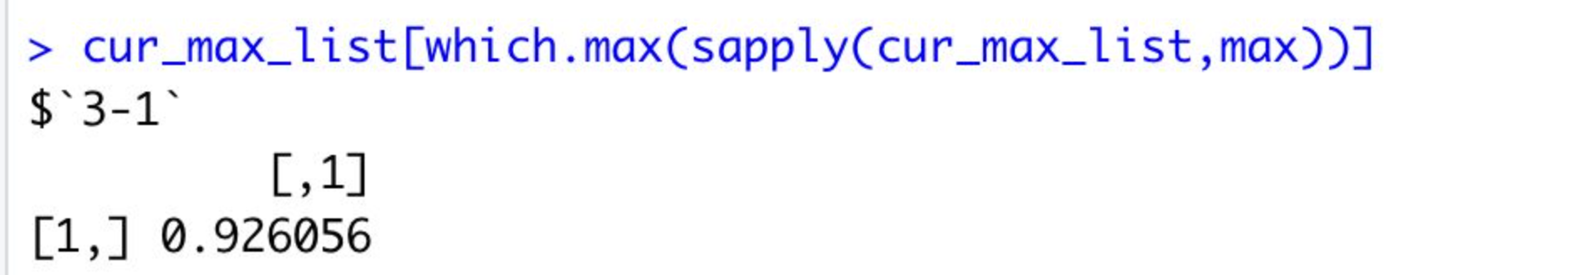
Testing our model
In this instance we got 3rd layer with 1st node configuration as highest accuracy.
2 Hidden layer with 1 to 3 nodes

Slide 18
Lessons Learnt
When do visualizations not help?
To use pair panels for visualization, we see that there were too many attributes which makes it confusing to interpret the data.
Data visualization cannot help if data has multicollinearity, it can lead to misinterpretation.
Visualization doesn’t help if data is too complex or cluttered to understand without numbers.

Slide 19
Lessons Learnt
When do visualizations help?
Visualization helps if data has less attributes.
Visualization will help identify the relationship or pattern in graphs when data points are not too cluttered.
For complex data plotting a correlation matrix is helpful as it highlights any higher or weaker relationship between variables.

Slide 20
Which neural network was the most accurate?
In our analysis we found neural network with 1 layer and 2 nodes configuration to be most accurate, with accuracy of 94.7% .

Slide 21
Thank You

